Slide 1
Data Mining with R for Predicting Student Success and Financial Aid Modeling
Presenter: Alex Rudniy, Ph.D.
Assistant Professor in Computer Science
Fairleigh Dickinson University

Slide 2
What is R?
System for statistical computation and graphics.
Consists of a language plus a run-time environment with:
Graphics,
A debugger,
Access to certain system functions,
And the ability to run programs stored in script files.

Slide 3
What is RStudio
Integrated development environment (IDE) for R.
Includes :
A console,
Syntax-highlighting editor that supports direct code execution,
Tools for plotting,
History,
Debugging
Workspace management.

Slide 4
R vs RStudio
R is the core, which does the work
RStudio is a shell, which makes R user friendly

Slide 5
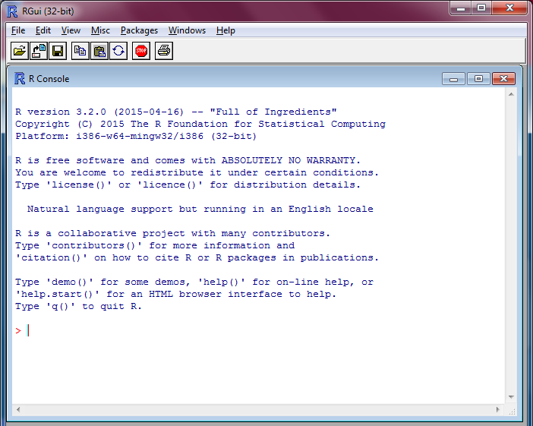
R Interface

Slide 6
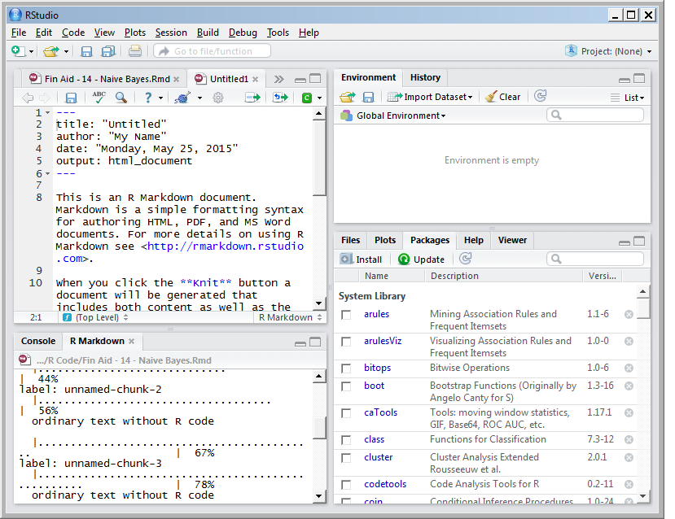
RStudio Interface

Slide 7
How to begin work in R?
Download and install R
Download and install RStudio

Slide 8
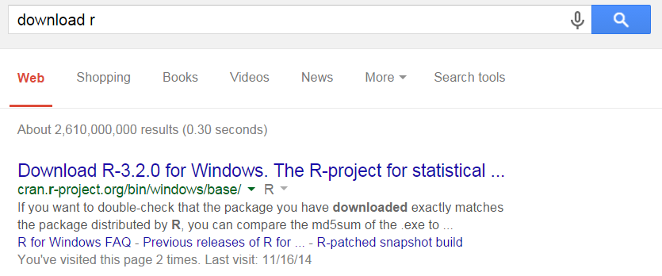
Download R

Slide 9
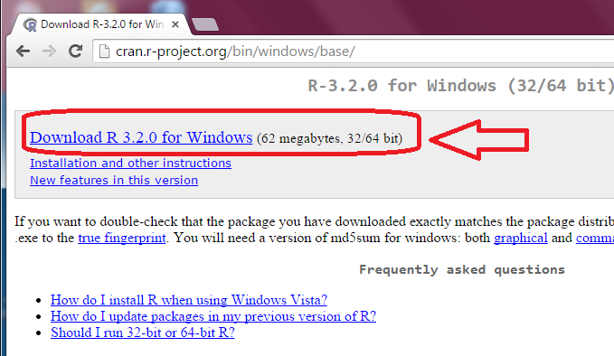
Downloading R

Slide 10
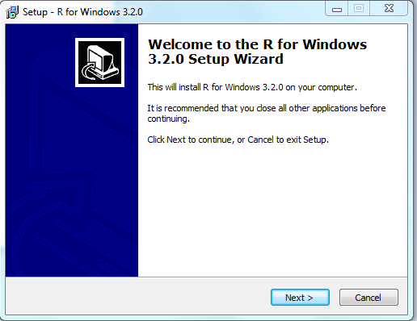
Installing R

Slide 11
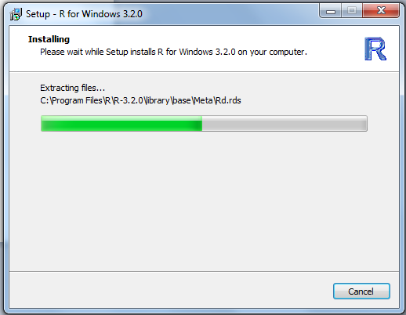
Installing R

Slide 12

R Installed

Slide 13
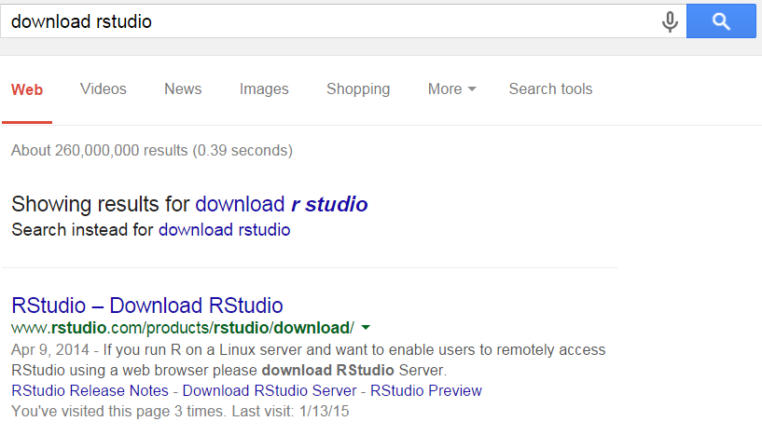
Download RStudio

Slide 14
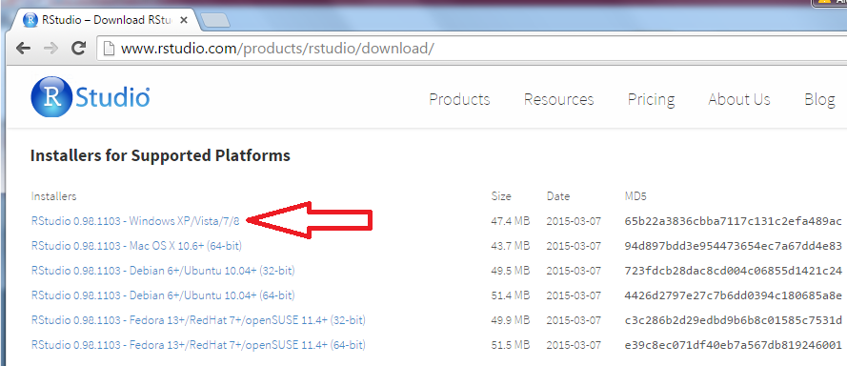

Downloading RStudio

Slide 15
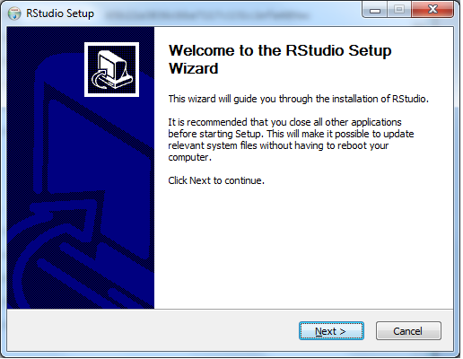
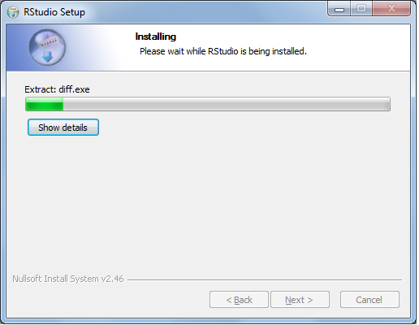
Installing RStudio

Slide 16
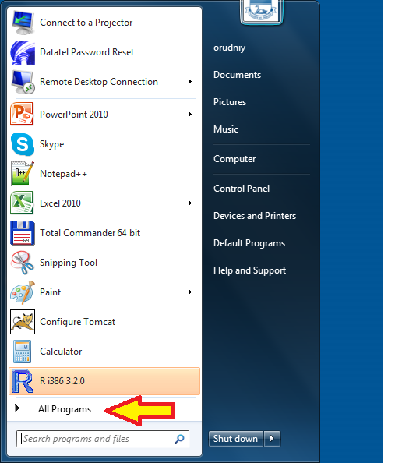
Starting R – step 1

Slide 17
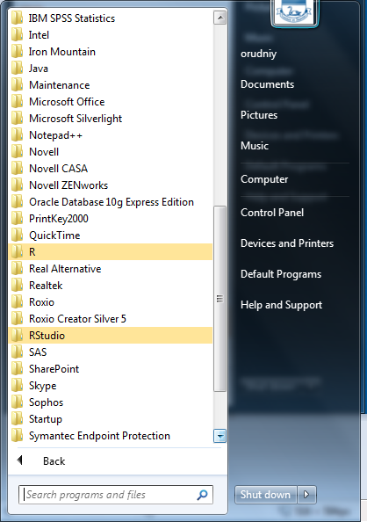
Starting R - step 2

Slide 18
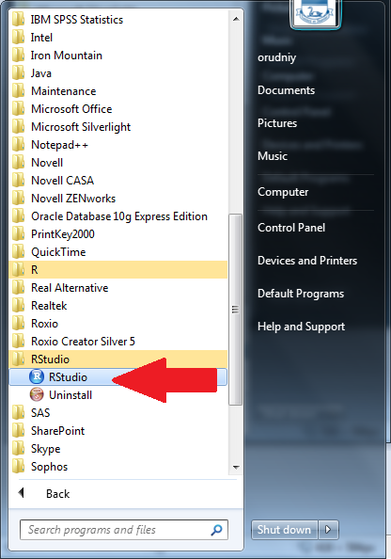
Starting R – step 3

Slide 19
What is R Markdown?
Authoring format that enables:
Easy creation of dynamic documents
Presentations
And reports from R
RMarkdown consists of :
An easy-to-write plain text format)
With embedded R code chunks, which results are included in the output.
Markdown documents can be automatically regenerated.

Slide 20
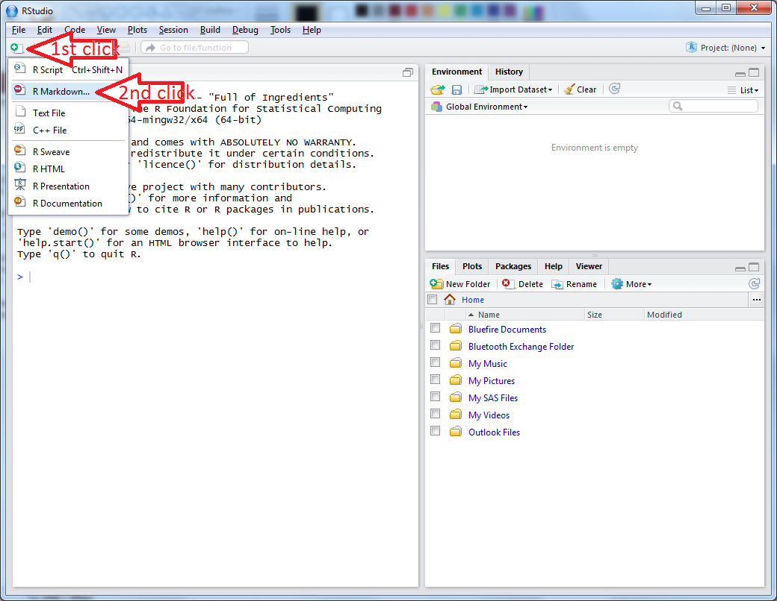
Make new R Markdown

Slide 21
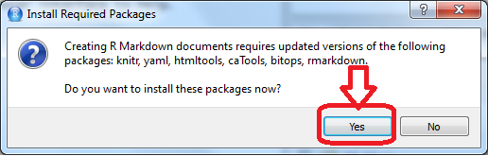
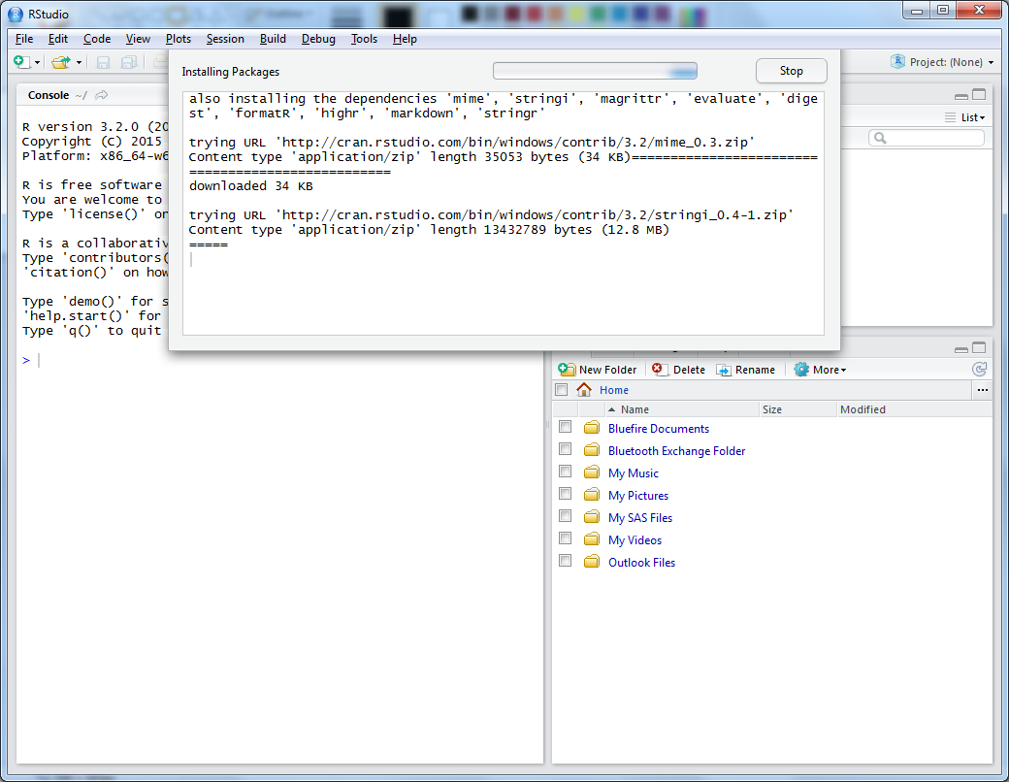
Warning message pops up
Rstudio will install necessary packages automatically from the Internet

Slide 22
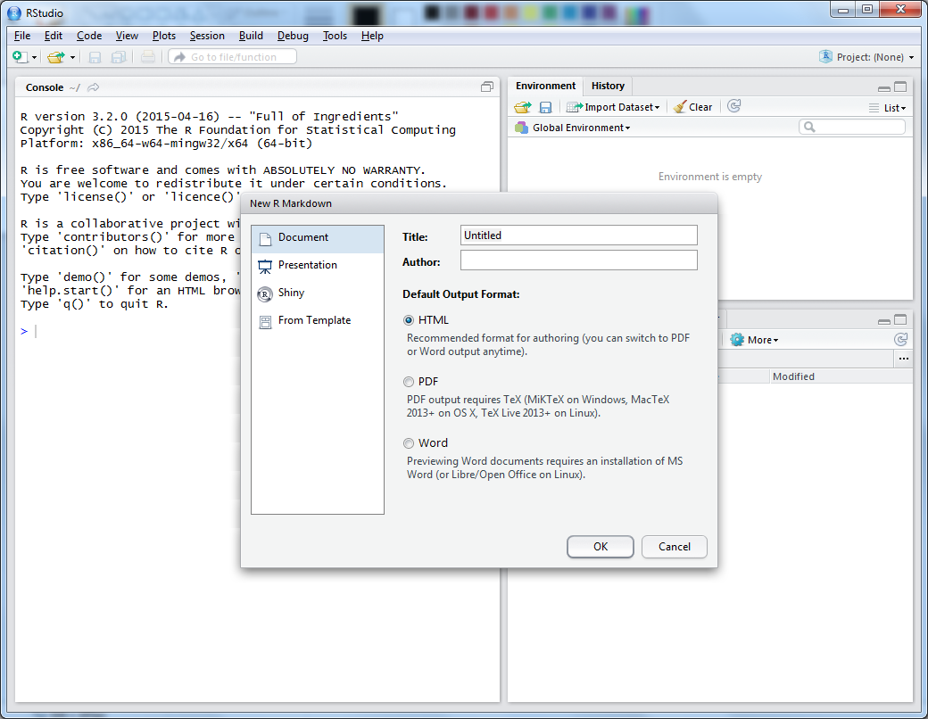
New R Markdown

Slide 23
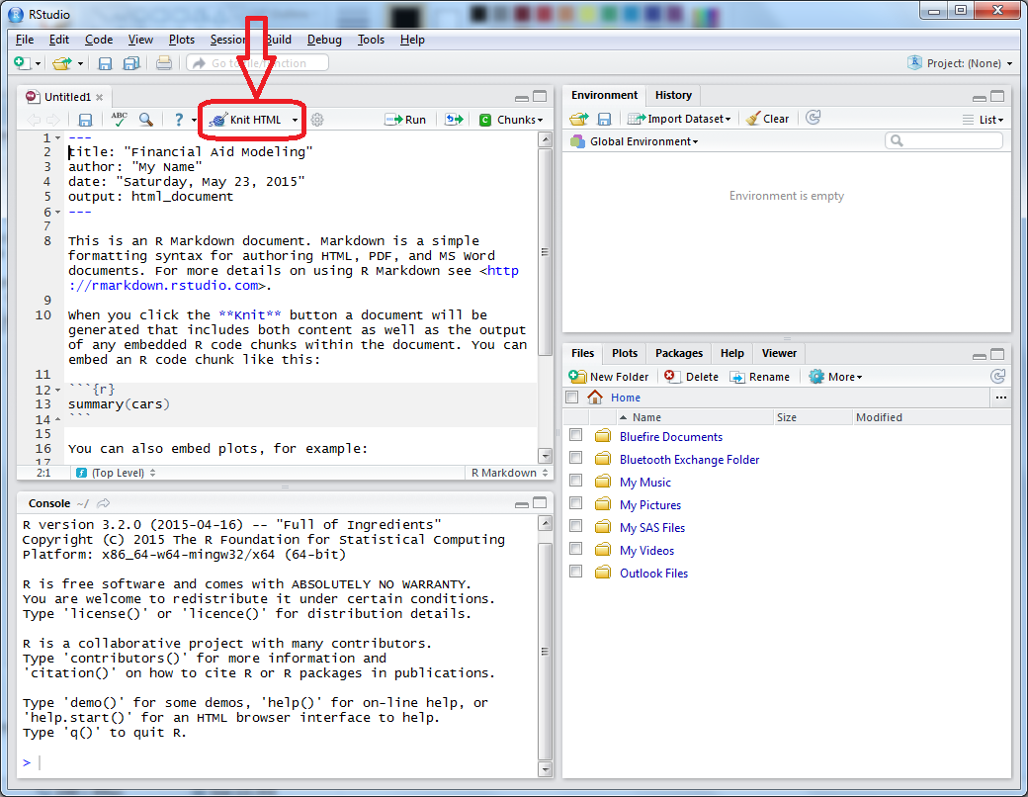
Knit an RStudio report

Slide 24
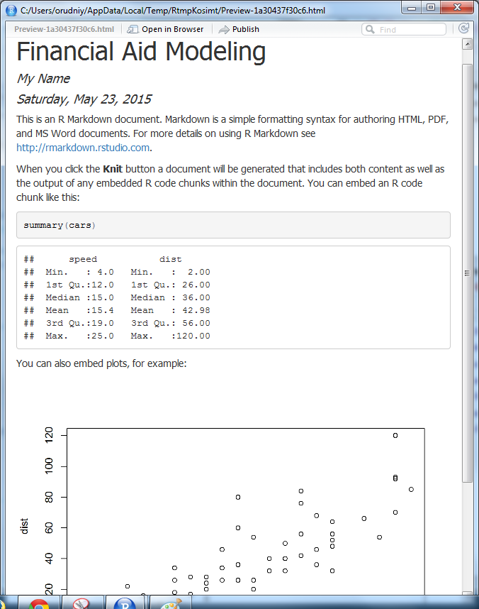
First RStudio Report

Slide 25
RStudio Report Types
HTML. Makes a web page.
Good for development and distribution
Available immediately
Word. Makes a MS Word document
Good for MS Word-oriented projects
Available immediately
PDF. Produces a PDF file.
Good for distribution by email
Good for publishing online
Requires a full installation of MikTex

Slide 26
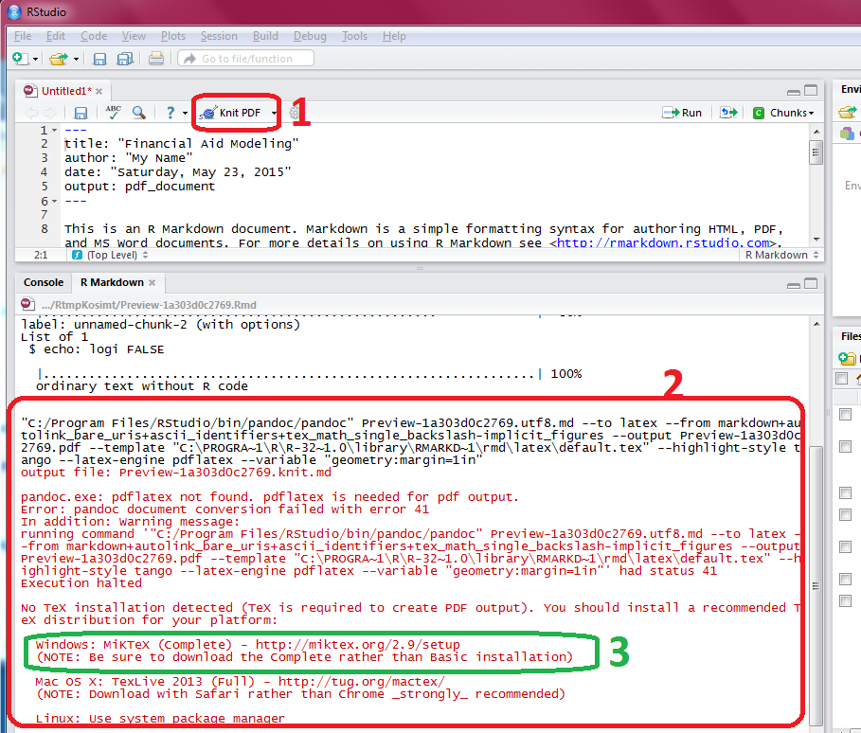
PDF requires MikTex

Slide 27
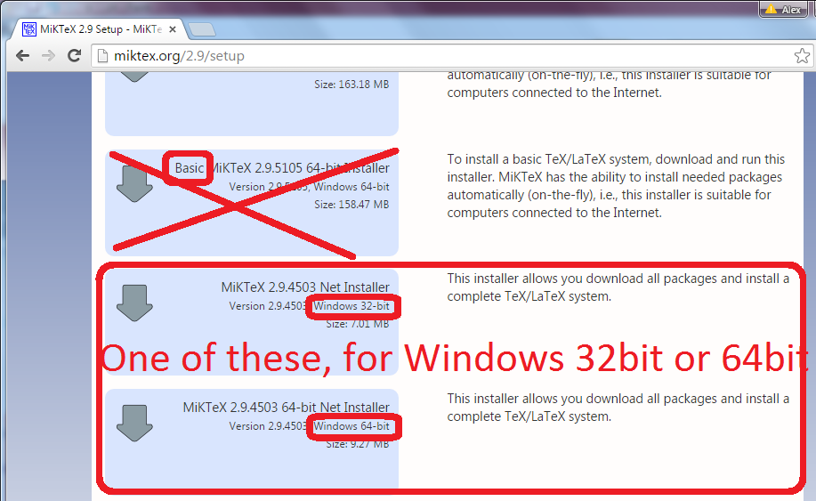
Install MikTex from http://miktex.org

Slide 28
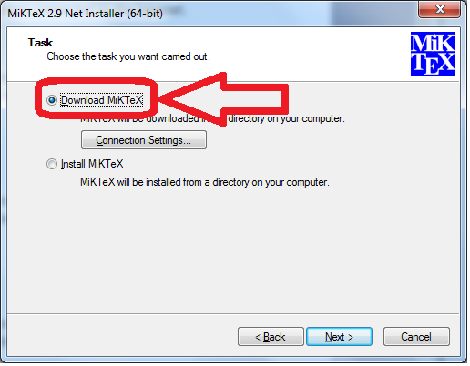
MikTex Installation

Slide 29
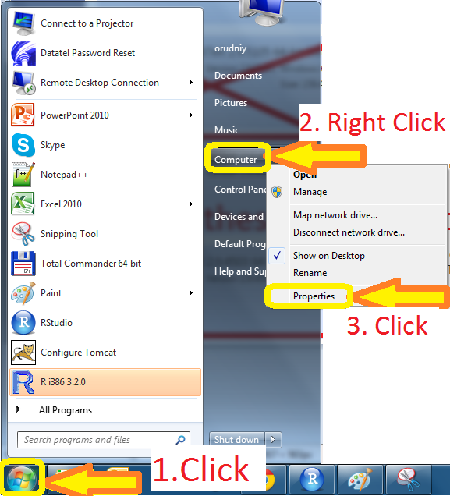
Identify Windows Version

Slide 30
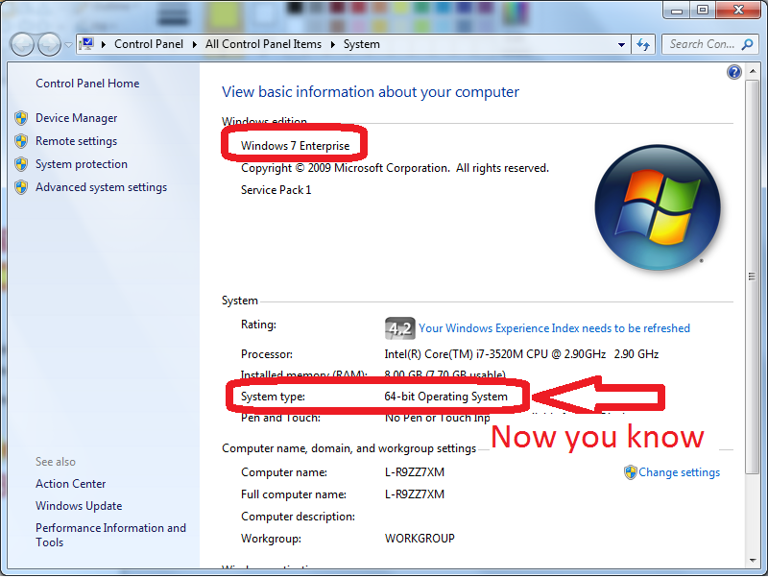
Which version? (Windows)

Slide 31
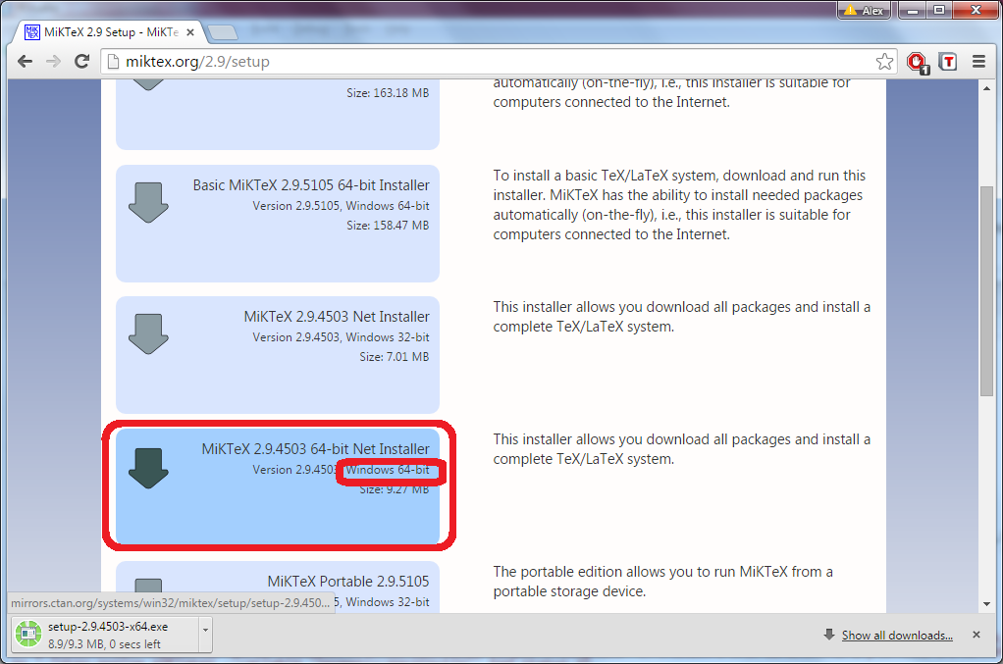
Download proper MikTex

Slide 32
Run MikTex Installer

Slide 33
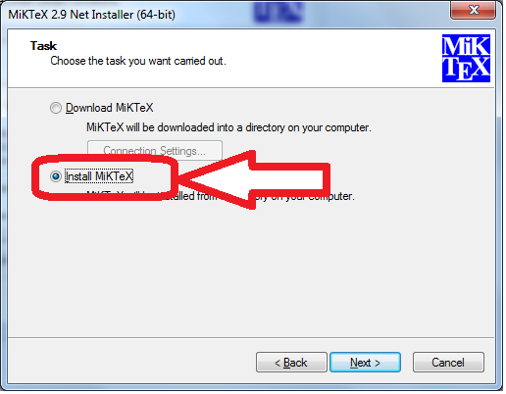
2nd Step: Install MikTex

Slide 34
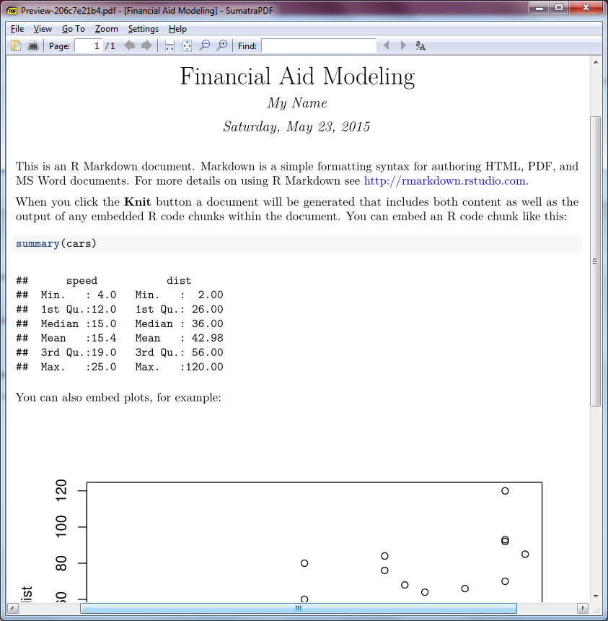
Finally, knit a PDF

Slide 35

Make a Working Directory
Create a new folder in an easy reachable place
E.g. on a Desktop
Set the location of a working directory in RStudio

Slide 36
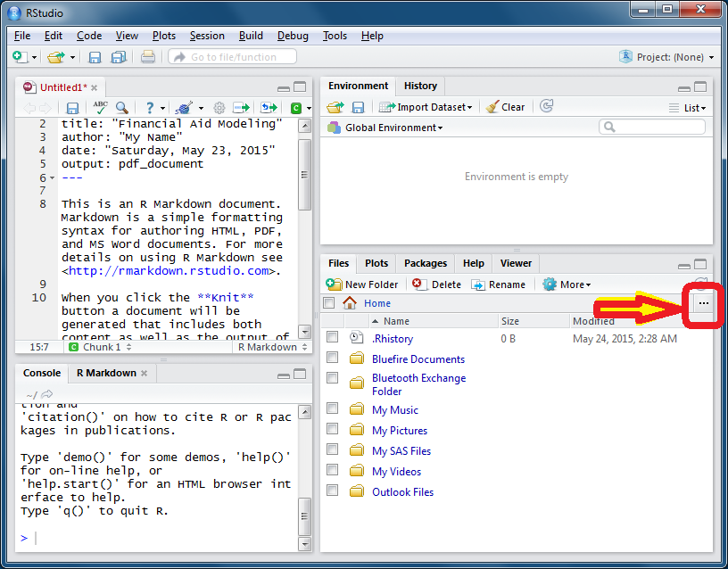
Set Working Directory

Slide 37
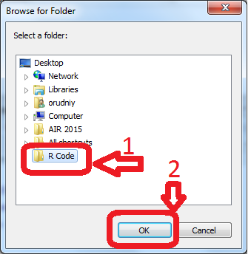
Pick WD Location

Slide 38
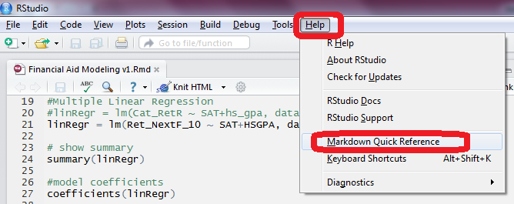
How to get help?
Plenty examples on the Internet
Find an example
Copy and paste code
Adjust code
Knit a report!

Slide 39
Markdown Quick Reference
Emphasis
*italic* **bold**
_italic_ __bold__
Headers
# Header 1
## Header 2
### Header 3

Slide 40
Markdown Quick Reference 2
Unordered List
* Item 1
* Item 2
+ Item 2a
+ Item 2b
Ordered List
1. Item 1
2. Item 2
3. Item 3
+ Item 3a
+ Item 3b

Slide 41
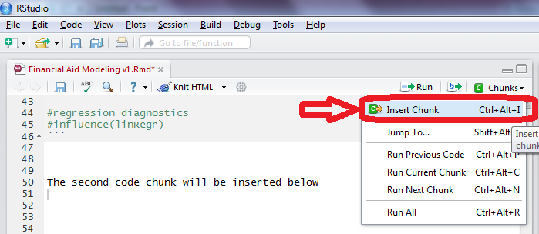
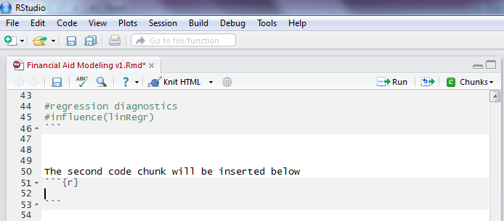
R code comes in “chunks”

Slide 42
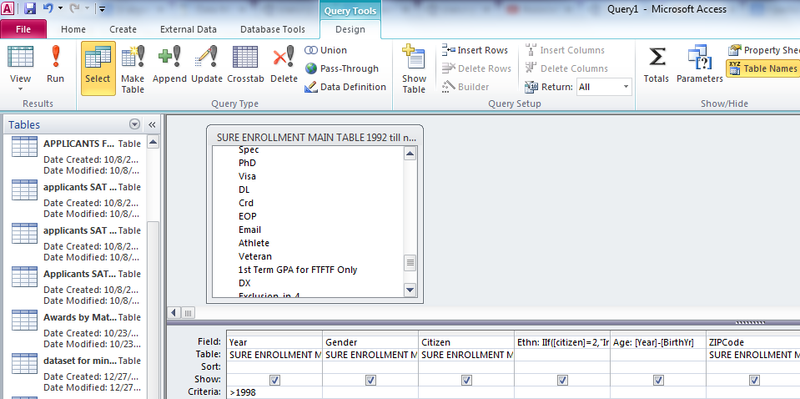
Data Pre-processing
MS Access
MS Excel
R / RStudio

Slide 43
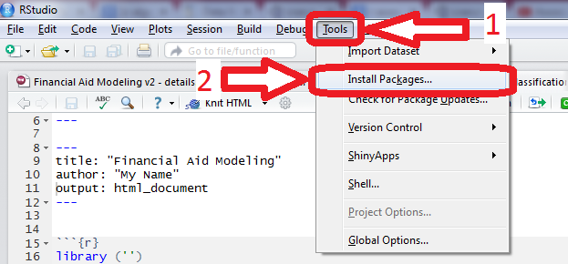
R Packages
Packages are collections of R functions and data.
Packages are stored as libraries.
R comes with a standard set of packages.
Others packages are available for download and installation (free of charge).
Once installed, they have to be loaded into the session to be used.

Slide 44
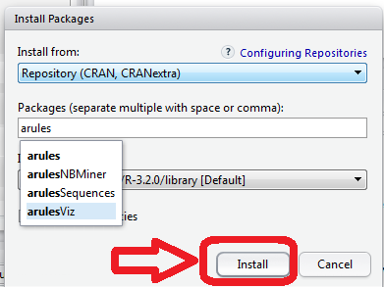
Install an R package

